Slide 1


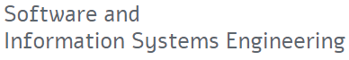
IoT device type identification
Yair Meidan
phd candidate @bgu
yair.meidan@gmail.com
https://www.linkedin.com/in/yairmeidandatamining/

Slide 2
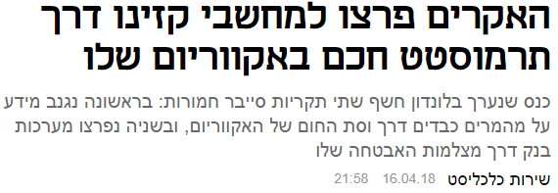
Background – IoT security
Mirai 2016

Slide 3
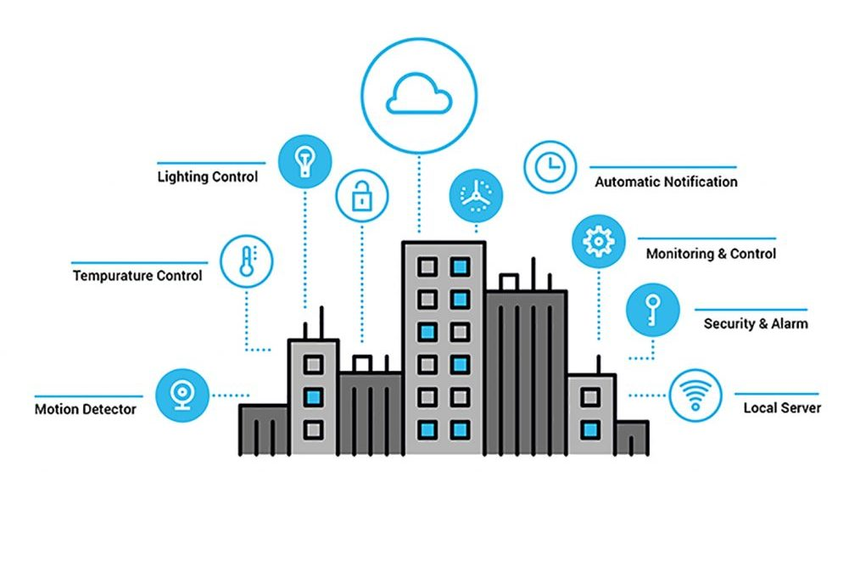
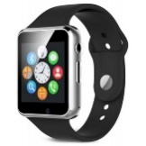
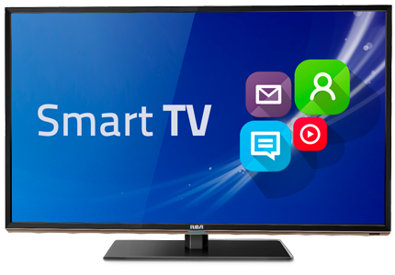
IoT challenges in large enterprises
Self-deployed vs. BYO-IoT
Attacked “thing” >> attacked business
Data leakage, legal liability, productivity loss, reputation, …
Large premises >> automation of
security policies enforcement (NAC)
asset management
intrusion detection (IDS)

Slide 4


Goals
What type?
IoT IP stream
Identification
(white-listing)
Authorized?
?

Slide 5
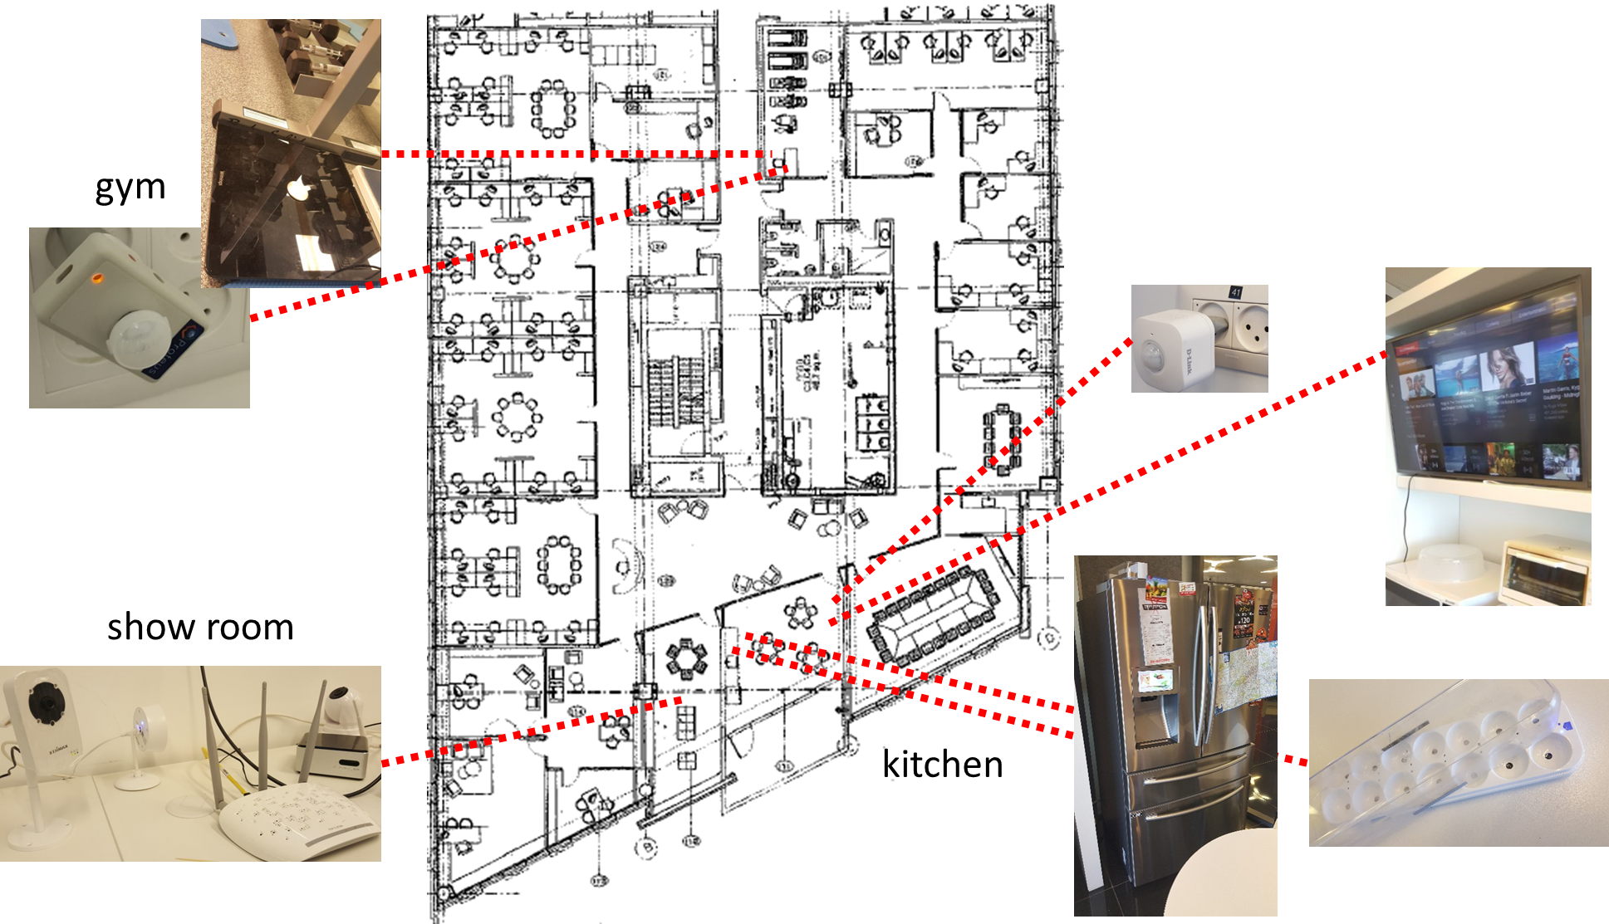
Deployment of IoT devices @BGU
Commercial IoT devices
Numerous & various
Natural use

Slide 6
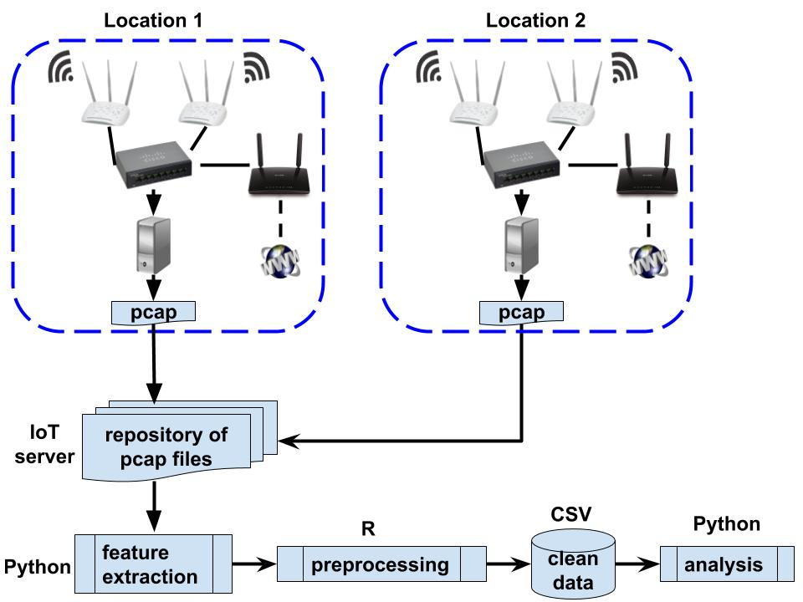
Data collection and preparation
BGU
SUTD

Slide 7
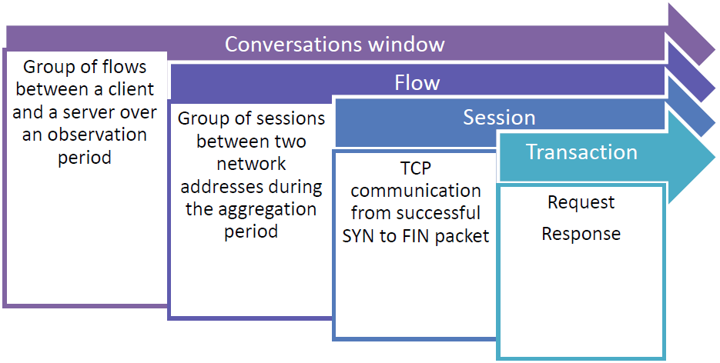

Feature extraction
Based on Bekerman et al. (2015)
“Feature Extractor” (Python)
pcap → transaction / session / flow / conversation window
~330 session-level features
# of ACK / PSH / RST packets sent / received, by client / server / both # of bytes sent / received, by client / server / both # of retransmitted packets ratio between # of bytes sent and # of bytes received session duration # of bytes sent by client over HTTP (min., Q1, median, avg., Q3, max, entropy, stdev) # of cookies (min, Q1, …) | HTTP request-response inter arrival time (min, Q1, …) SSL handshake duration (min, Q1, …) ratio between ssl sessions and expired certificates (min, Q1, …) TCP packet time-to-live sent by client / server / both (min, Q1, …) dominated host Alexa rank server port is user / system / dynamic protocol is DNS/ HTTP / SSL …

Slide 8
Problem formulation
Input: A feature vector describing a session
Output: The type of IoT device which generated this session
Sometimes a type is represented by multiple devices and/or manufacturers
We aim at generalization
Not all types in the training set are represented in the validation/test sets (and vice versa)
>> an unknown device should be marked ‘unknown’

Slide 9
Data structure
Input: a CSV file
297 features in the training set + ‘device_category’ as label
297 features in the validation / test sets + session_ind
Output: a CSV file
2 columns
session_ind
device_category
predicted
Missing predictions will be filled with ‘unknown’
session_ind | Device_category
1 | security_camera
2 | watch
3 | unknown
… | …
1000 | TV
output CSV structure example

Slide 10
Evaluation
80%: Classification accuracy on a given (balanced) test set
On the test set: (#_correct_predictions) / (#_total_sessions)
20%: Innovation & creativity
10%: Algorithmic approach
4%: Feature selection (qualitative & quantitative)
2%: (Hyper)Parameter tuning
2%: Class balancing
2%: Feature extraction / engineering

Slide 11
Benchmark code & model
A full (yet simple) solution will be given at the main event
Reading csv
basic data exploration & preparation
training & predicting using SK-Learn
writing output and evaluating
Jupyter Notebook

Slide 12
Good luck!

